Slide 1
POLISH NORWEGIAN COOPERATION FOR ENVIRONMENTAL FRIENDLY AND INNOVATIVE SOLUTIONS IN SMES - POLNORECO CRACOW, 31 MARCH 2016

Slide 2
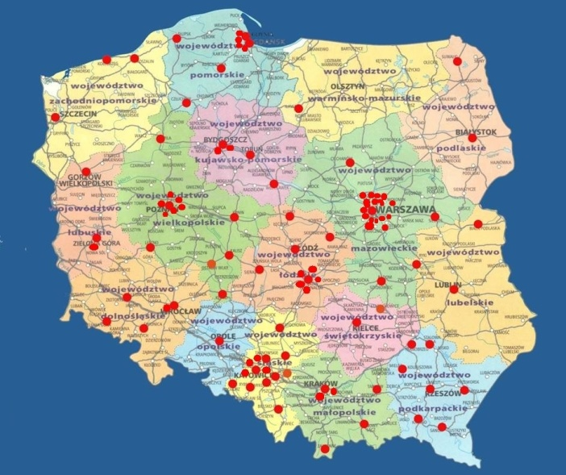
PROJECT PARTNER POLISH CHAMBER OF COMMERCE m a i n a c t i v i t y
Creation and evaluation of economic policy in Poland (committees, environment)
Foreign relations and promotion
Conferences, forums, seminars
Trade arbitration
Services, for example: documents legislations, training courses, publications
Special projects
EU funded projects
Networking
REGIONAL AND LOCAL CHAMBERS - 53
INDUSTRY ORIENTED ASSOCIATIONS - 71
BI - AND MULTILATERAL CHAMBERS - 18
OTHER ORGANIZATIONS – 10
CURRENTLY: 152 MEMBERS

Slide 3
PCC Projects
2006-2015 – over 50 projects, budget over 50 mln euro
„New qualifications work entrepreneurship for unemployed women”, 6500 women trained, 2000 new companies, 10 mln euro
„PCCNET” – 86 partners, 10 mln euro, development of chambers activities in Poland
„PCCNET – Innovations”, 10 mln euro over 400 new services supporting innovations in Polish companies

Slide 4
PCC Projects
„EUREMplus”, 10 european countries, educational program for energy engineering and optimizing its consumption, certificates European Energy Manager (Intelligent Energy Europe Programme)
„Promotion of best practices Polish Chamber of Commerce” (Norway grants), 100 practises identified, workshops for 417 participants, regional and local development by knowledge transfer
„The agreement of enterpreneurs in terms of the creation and maintenance of the system for the collection, transport, recovery or disposal of packaging waste”

Slide 5
PROJECT PARTNER INTERNATIONAL DEVELOPMENT NORWAY AS m a i n a c t i v i t y
IDN is a spin-out from SINTEF foundation, the largest contract research institute in Scandinavia. Our focus areas are business development, innovation, energy/environmental technology and commercialization of technology. We are a network oriented organization engaging researchers from SINTEF/NTNU and other experts from Norway and abroad in our projects. An important component in all our projects is matchmaking with Norwegian companies. At the moment we have ongoing projects in Poland, Latvia, Slovakia, Hungary, Romania, Bulgaria and Ukraine.
Services:
MARKET RESEARCH & FEASIBILITY STUDIES
PROJECT DEVELOPMENT & MANAGEMENT
BUSINESS PARTNERING & TECHNOLOGY TRANSFER
GREEN INDUSTRY INNOVATION IN RENEWABLE ENERY AND ENVIRONMENTAL TECHNOLOGY
JOB CREATION AND LOCAL ECONOMIC DEVELOPMENT

Slide 6
PROJECT PARTNER Relevant experiences from NORWAY and CEE
17 projects in National Program for SME Business Development in Networks (Idesøk) (1990-2015)
National SME Technology Transfer Programs (1985-2015) (more then 170 companies supported)
IRC/EEN (1986-2011)
11 EEA/Norway Grant Projects in Green Industry Innovation

Slide 7
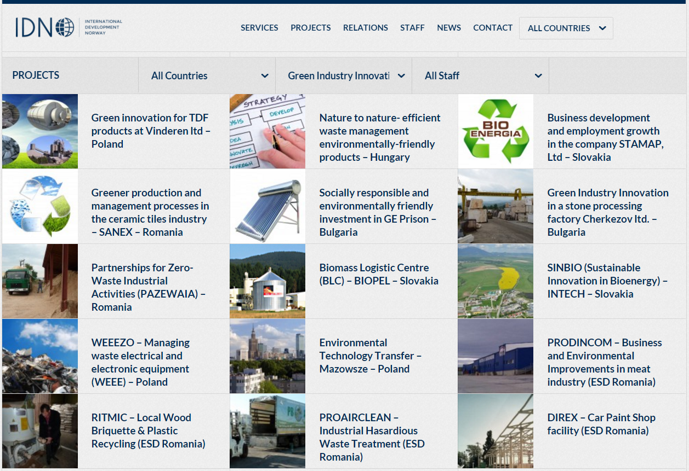
PROJECT PARTNER Relevant experiences from NORWAY and CEE

Slide 8
I N S P I R A T I O N S
Improving energy efficiency of SME
The act on energy efficiency of 2011
Effective management of resources - waste and emissions
The waste act of 2012
The act on packaging and packaging waste of 2013
Use of renewable energy
Directive 2009/28/EC on promotion of the use of renewable energy sources
(1) PROBLEMS
(2) ACTIVITIES
(3) COMPANY PROJECTS
(4) WORKSHOPS
& TOUR STUDIES
(5) BEST PRACTISES
(6) DISSEMINATION
(7) EVALUATION
(8) IMPLEMENTATION

Slide 9
C H A L L E N G E S
Improvement of the energy efficiency of SME
Effective management of the resources – waste and emissions
The use of renewable energy

Slide 10
W E A K N E S S E S
Threat to sustainable development - economy, environment, human
Energy loss – buildings, objects, production processes, transmission networks
Small energy recovery in industrial processes
Inefficient resource management - waste and emissions
Insufficient use of renewable energy sources
Lack of competence and low knowledge employees – lack of planning

Slide 11
A C T I V I T I E S
Insulation, modernisation of industrial installations
Reconstruction or renovation of buildings, objects
Increasing the recovery of energy in production processes
Implementation of the less waste production and technological solutions
Increasing the use of renewable energy in production processes
The increase in the use of waste as resources
Reduction of emissions to the environment
Education - increase of the awareness, knowledge and competence
Implementation of the standards of assessment and planning for sustainable development
Popularization of best practices

Slide 12
APPROACH
Innovative tailor made solutions in two companies located in Eastern Poland
Complex approach to environmental challenges of the SME
Developed with Norwegian technology experts
In accoradnce with methodology well tested in Norway

Slide 13
HOLISTIC APPROACH
Fulfilling
EU/national regulations
External Green Footprint
Investments in:
Energy Efficiency
Material Efficiency
Renewable Energy
Working Environment (HSE)
Productivity
Profitability

Slide 14
INNOVATIVE, TAILOR MADE COMPANY PROJECTS
Phase | Partners involved
Identification and choice of the company | KIG, local stakeholders, IDN
Collection and analysis of the data – (desk, study, interview with local chambers of commerce, site visits in the company) | KIG, IDN
State of the art in the Company Report. | KIG, IDN
Identification of priority areas for the Company | KIG, IDN, Company
Analysis of possible solutions. | KIG, IDN
Identification and approval of Company Projects | KIG, IDN, Company
Development of deployment documentation for tailor made Company Projects | KIG, IDN
Development of the project proposal to one of the available mechanisms enabeling to implement the investment) | KIG, Company

Slide 15
COMPANY PROJECTS – OVERALL PHILOSPHY
Energy efficiency in the company should go in pararell with the business development

Slide 16
COMPANY PROJECT
TARGET : TO IDENTIFY 2-3 IMPROVEMENTS AREAS FOCUSING
ON GREEN AND ENERGY EFFICIENT BUSINESS
FINANCING
2. Performance
3. Gap closing
1. Planning
Application to
available funding
mechanism
Notes:
* Audit is not sufficient, audit it is just state of the art, we are focusing more on the future recommendations

Slide 17
THE GOAL OF THE COMPANY PROJECTS
To meet the
legal requirements
appropriate for the company
( reg. environmental performance,
especially energy efficiency – energy audit, waste audit)
To strengthen
energy efficiency
in the company
GOALS
To identify
(new) business
opportunities
beyond energy
efficiency
To build
the partnership
for the greener business
Notes:
To identify 2-3 improvements areas :
To meet the legal requirements appropriate for the company ( reg. environmental performance, especially energy efficiency)
To strenghten energy efficiency of the company
To identify (new) buisness opportunities beyond energy efficiency
To build the partnership for the greener buisness ( in the regional but also bilateral, Polish-Norwegian dimension)

Slide 18
SUCCESS FACTORS OF THE APPROACH
Tailor made recommedation, considering all relevant factos like (company size, ownership structure, industry sector, energy intensity, energy supply issues and geographical location.)
2. Focus on benefits beyond energy savings. Energy efficiency investments should bring such as enhanced productivity, product quality and new buisnnes opportunities.
3. Comprehensive approach :
Information ( audit, experts report and recommendation)
Capacity building (improving skills and knowledge of in-house personnel and external stakeholders )
Financing ( helping to access funding)
4. Building local partnertship

Slide 19
COMPANY PROJECTS – GREEN AND ENERGY EFFICIENT BUISNESS
STEP 1
Pre-visit preparation
Confidentiality agreement
Desk study for the company
1st questionnaire (filled in by local chamber of commerce
Planning
Optimize company perfomance

Slide 20
COMPANY PROJECTS – GREEN AND ENERGY EFFICIENT BUISNESS
STEP 2
Visit to the company
Company visit ( 3 days)
On site procedures ( in depth interviews, documents rewieves, workshops)
Milestone : draft report on green business developement
Planning
Performance
Optimize company perfomance

Slide 21
COMPANY PROJECTS – GREEN AND ENERGY EFFICIENT BUISNESS
STEP 3
Reporting and
recommendation
Planning
Desktop rewiewes
Identyifing technologies and solutions applicable
Issuing draft/final report for the company
Performance
Optimize company perfomance
Gap closing

Slide 22
COMPANY PROJECTS – GREEN AND ENERGY EFFICIENT BUISNESS
CORE PRODUCTION PROCESS
INFRASTRUCTURE
DRIVE SYSTEMS : ENGINS, PUMPS, FANS
AND COMPRESSORS
MACHINES AND EQUIPMENT
LIGHTNING
OFFICE EQUIPMENT
HEATING, VENTILATION, AC
OF THE SPACE
GREEN FOCUS
PRODUCTION LAYOUT
VALUE CHAIN
SUPPORT SERVICES
WASTE,
EXCHANGERS, HEAT PUMPS
SUN COLLECTORS, PHOTOVOLTAICS
PROCESSES REDESIGN
ALTERNATIVE SOURCES
Notes:
Układy napędowe: silniki elektryczne, pompy, sprężarki i wentylatory
Oświetlenie
Komputery, sprzęt RTV, wyposażenie biur i pomieszczeń usługowych, AGD
Ogrzewanie, wentylacja i klimatyzacja (chłodzenie) budynków
Termomodernizacja budynków ...........
Skojarzone wytwarzanie ciepła i energii elektrycznej ....................................................................... 74 2.7. Ciepło odpadowe, wymienniki oraz pompy ciepła ............................................................................. 75 2.8. Kolektory słoneczne i ogniwa fotowoltaiczne, ściany solarne....................................................... 78

Slide 23
Energy efficiency in the SME -
Examples of equipment, controls, software and services to be
EQUIPMENT
Insulation
Efficient lighting
Smart meters and monitoring systems Waste heat recovery systems
Efficient windows and glazing
Variable speed drives Efficient office and industrial equipment Voltage power optimisation equipment.
CONTROLS AND SOFTWARE
Automated monitoring and targeting systems
Boiler controls
Building energy management systems
Heating, ventilation and AC controls
Energy management software
Lighting and daylight phasing
control and occupancy control
Process energy management systems
Energy use analytics
SERVICES
Energy auditing
Energy checks (energy walkthroughs)
Energy management
Energy management system
implementation support
Energy performance contracting
Process optimisation support
Energy efficiency consultancy
Maintenance for energy
efficiency

Slide 24
GREEN AND ENERGY EFFICIENT BUISNESS – BENEFITS FOR THE COMPANIES
1
2
Get the picutre of the energy performance of the company
2
1
3
4
Get qualified recommendations for green buisness development
3
Meet relevant energy legal requirement and permissions
4
Build the capacity ( internal and external) for further green innovations

Slide 25
EXAMPLES OF S O L U T I O N S
Energy Efficiency
Invest in more energy efficient production equipment
Optimization of energy usage
Recycling of process water
Isolation of buildings
Material Efficiency
Alternative materials and optimization of material usages
Design and Distribution solutions to reduce packaging
Reuse/Recycling of packaging
Find external users/buyers of bi-products (waste)
Renewable Energy
Replace oil/coal with bio-mas in heating boilers
Use of bi-products in energy production
Solar heating of process water
PV power production on roofs

Slide 26
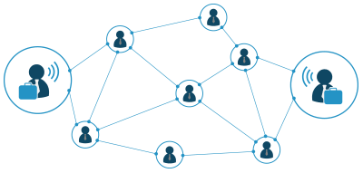
B I L A T E R A L C O O P E R A T I O N
Exchange of experience at institutional level between the organisations involved on both the Polish and the Norwegian side in the implementation of the project
Exchange of experience between experts involved in the project implementation in the field of technology and environment friendly solutions
Exchanges of experience in the area of the organisation of the SME support system - (Kompetansemegling, VRI Trøndelag especially in terms of the model triple helix
Participation of two Norwegian experts in the pilot projecst implementation
Study trip to Norway
Participation of Norwegian stakeholders/SMEs in incubation of national wide implementation and final conference.

Slide 27
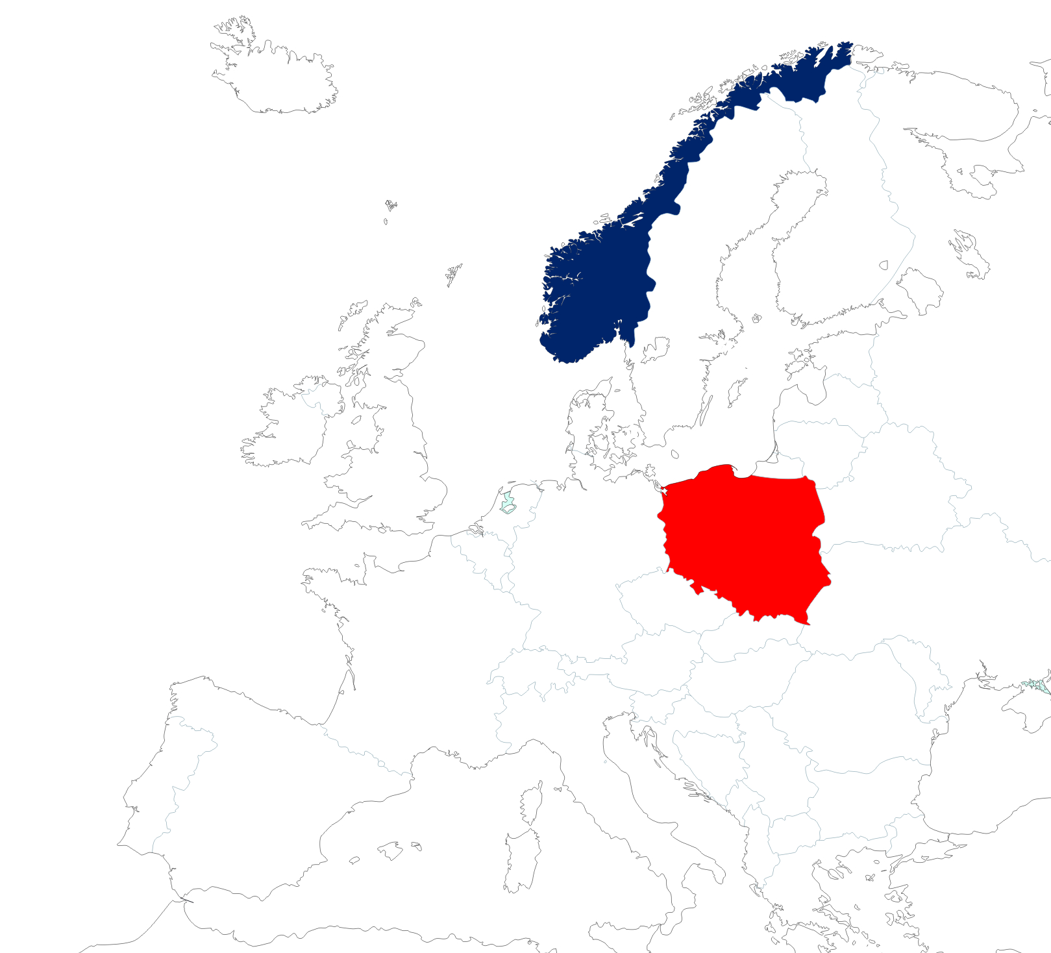
P R O J E C T A I M S
Building communication platform, cooperation in the field of the promotion and preparation of recommendations for the implementation of environmental innovation in the group of SME.
Strengthening Norwegian-Polish cooperation on the exchange of know-how and technologies to increase the energy efficiency of SME and more effective management of recourses
Incubation of best practices developed within the project for wide implementation in Poland.
Increase of knowledge and skills of entrepreneurs of the group SME in Poland
TARGET GROUP
Project is addressed to SME in Poland established in the field of industrial processing with emphasis on the production of wood and wood-based materials and the processing of fruits and vegetables.

Slide 28
P R O J E C T A C T I V I T I E S
Information campaign and recruitment of participants of the project – cooperation with regional chambers of commerce, dedicated mailing, social and branch media, newsletter
Implementation of 2 pilot innovative projects in Lubelskie and Podlaskie Voivodeship – 2 audits, 2 reports, 2 workshop
Popularization of environmental innovation
– study visit in Norway, 3 conferences, web-based platform
Educational component
– 13 seminars in Poland, e-education

Slide 29
P R O J E C T R E S U L T S
Partnership agreements / Letters of intent – 16
New technologies / new practises – 3
Articles / publications – 10
Audits – 2
Expert reports – 2
Workshops / partcipants – 2 / 16
Study visit / participants – 1 / 20
Conferences / participants – 3 / 260
Seminars / participants – 13 / 390
Number of visits to web platform – 100 000

Slide 30
DZIĘKUJĘ TAKK THANK YOU

